Slide 1



Intelligent Flow Challenge Team Senior Overfitters
Notes:
AI-generated content may be incorrect. --- This presentation addresses the innovative approach taken by Valmet and HSY to optimize sewage pump control using intelligent flow design. We will cover the challenge background, our solution approach, results, and future directions.

Slide 2
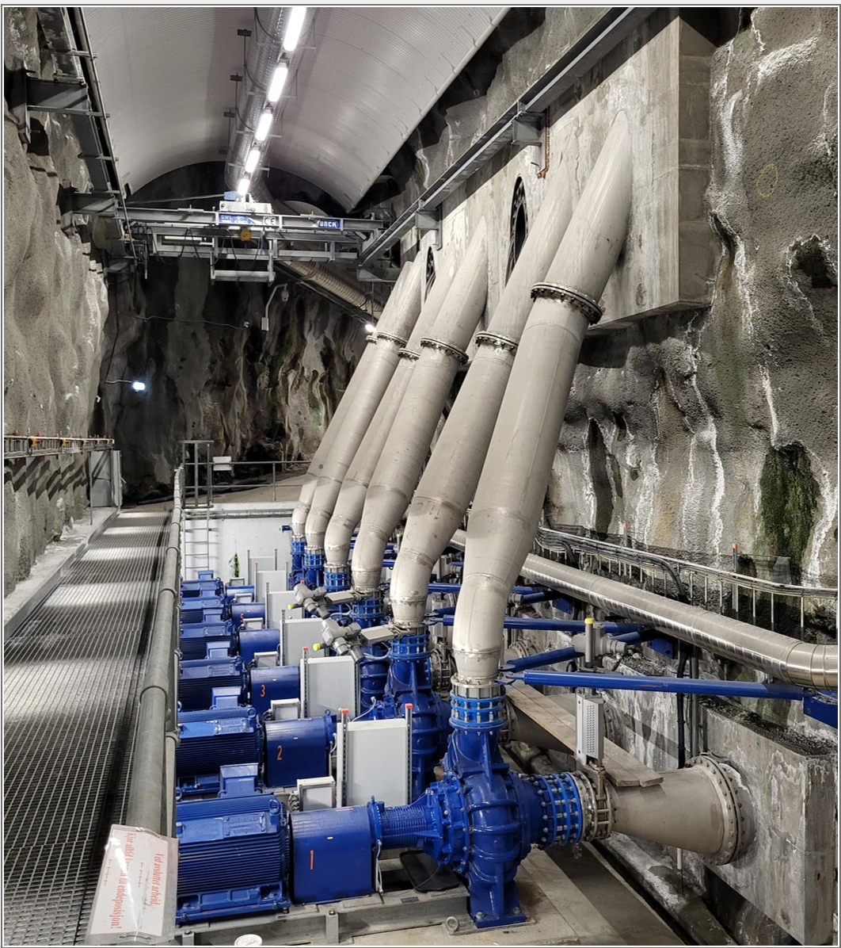


THE CHALLENGE: SMART SEWAGE PUMP CONTROL
Electricity costs 50-60% of operational expense, up to 50k€+ per week
HSY pumps currently operated manually without precise optimization based on electricity spot prices
AI and optimization bring huge potential
Notes:
--- The core challenge involves developing a smart control system for sewage pumps that optimizes flow management, reduces energy consumption, and improves system reliability in variable conditions. Image source: Microsoft 365 content library

Slide 3

OUR hackathon journey
CP-SAT became our fastest and most reliable core optimizer.
AI in key role: ML-driven weather and inflow signals and price forecasts
AI-assisted coding with Cursor + ChatGPT
Next step: AI-enhanced MPC/MILP for continuous, predictive pump control
Notes:
--- Looking ahead, we plan to enhance predictive capabilities, incorporate machine learning for adaptive control, and expand the system to cover additional sewage infrastructure components. Image source: Microsoft 365 content library

Slide 4
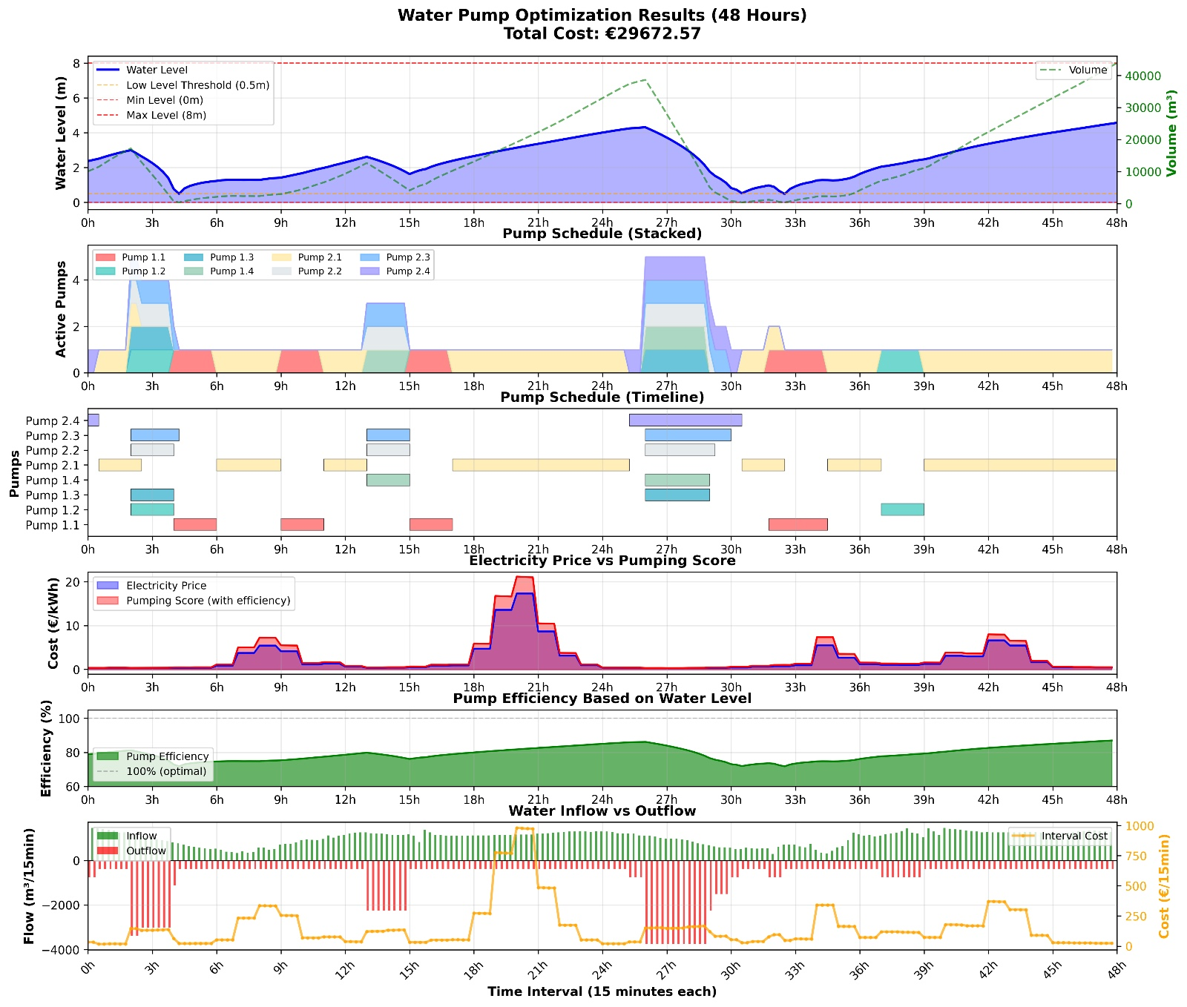
WHAT WE IMPLEMENTED DURING JUNCTION (1)
An optimization algorithm CP-SAT* solver using Google’s OR Tools’ library, built in Python
Real-time & historical electricity prices from ENTSO-E
Rainfall forecast from open meteorological API
Short-term electricity price forecast from Sähkövatkain
Solution on the right with constraints & inputs:
Water level < 0.5m every 24h
Water level < 8m always
Minimize electricity costs
Pumps on/off at least 2h per go
Forecasted inflow
Rainfall forecast
Real electricity prices
Pump efficiency as a function of water level height and frequency
***ANYTHING ELSE, WHAT??
*Constrained Programming with Boolean Satisfiability
Notes:
--- The core challenge involves developing a smart control system for sewage pumps that optimizes flow management, reduces energy consumption, and improves system reliability in variable conditions. Image source: Microsoft 365 content library

Slide 5
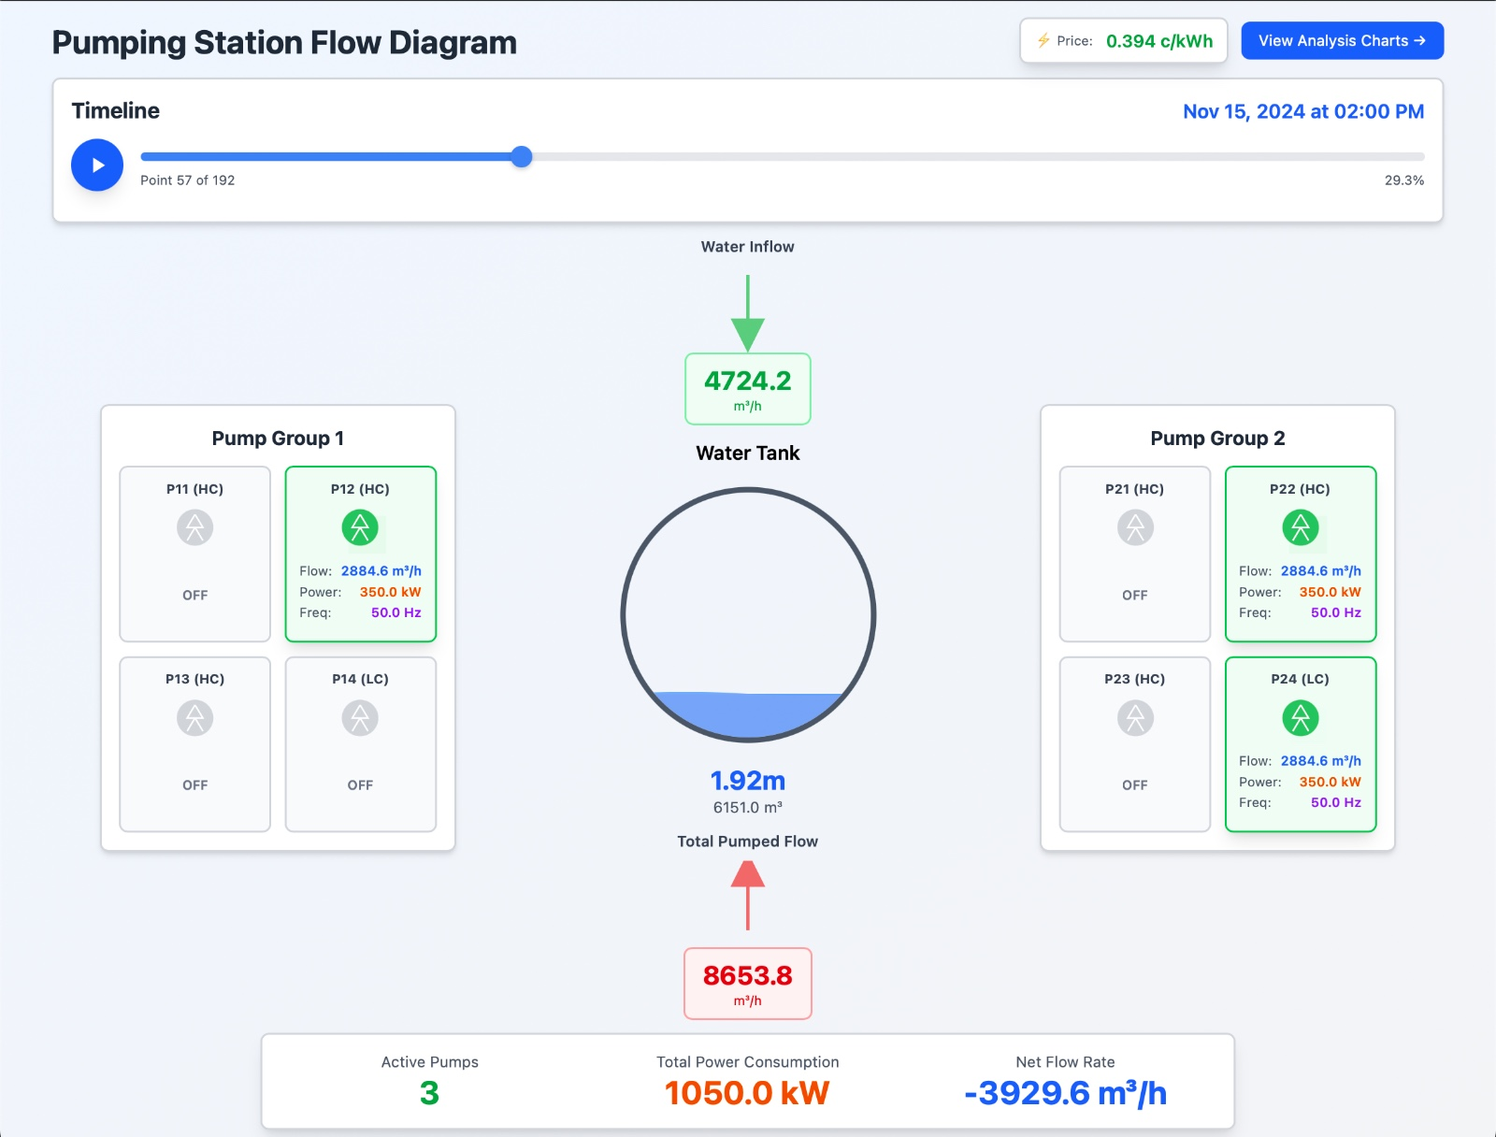
WHAT WE IMPLEMENTED DURING JUNCTION (2)
An intuitive monitoring dashboard
Includes gauges for water level in inflow tunnel, state of all pumps, inflow, total pumped flow and power consumption
Integrated with electricity price data
Next: integrate with Python backend
Built in Cursor with Svelte
Notes:
--- The core challenge involves developing a smart control system for sewage pumps that optimizes flow management, reduces energy consumption, and improves system reliability in variable conditions. Image source: Microsoft 365 content library

Slide 6
FUTURE EXTENSIONS
Continuous pump control with industry-standard Model Predictive Control (MPC) or Mixed-Integer Linear Programming (MILP)
Pump Efficiency and Durability Optimization with true efficiency curves and engineering information
AI Inflow Forecasting with historical data, and behavioral and groundwater models
AI-based Electricity Price Forecasting
Notes:
--- The core challenge involves developing a smart control system for sewage pumps that optimizes flow management, reduces energy consumption, and improves system reliability in variable conditions. Image source: Microsoft 365 content library

Slide 7
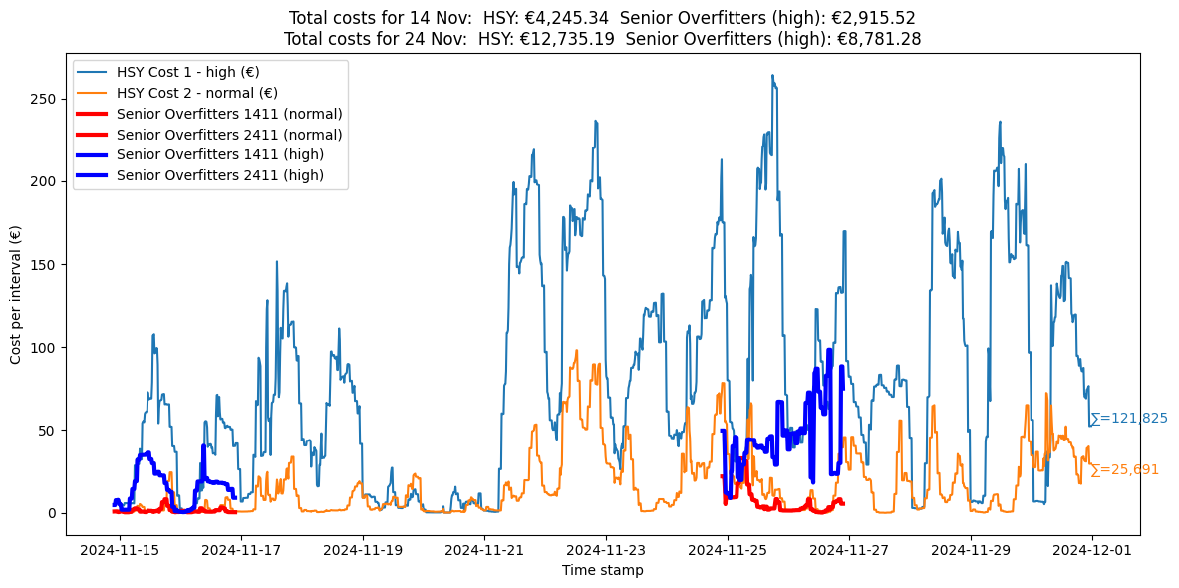
SAVE OVER 30% WITH OUR CP-SAT OPTIMIZER
Notes:
--- The core challenge involves developing a smart control system for sewage pumps that optimizes flow management, reduces energy consumption, and improves system reliability in variable conditions. Image source: Microsoft 365 content library

Slide 8
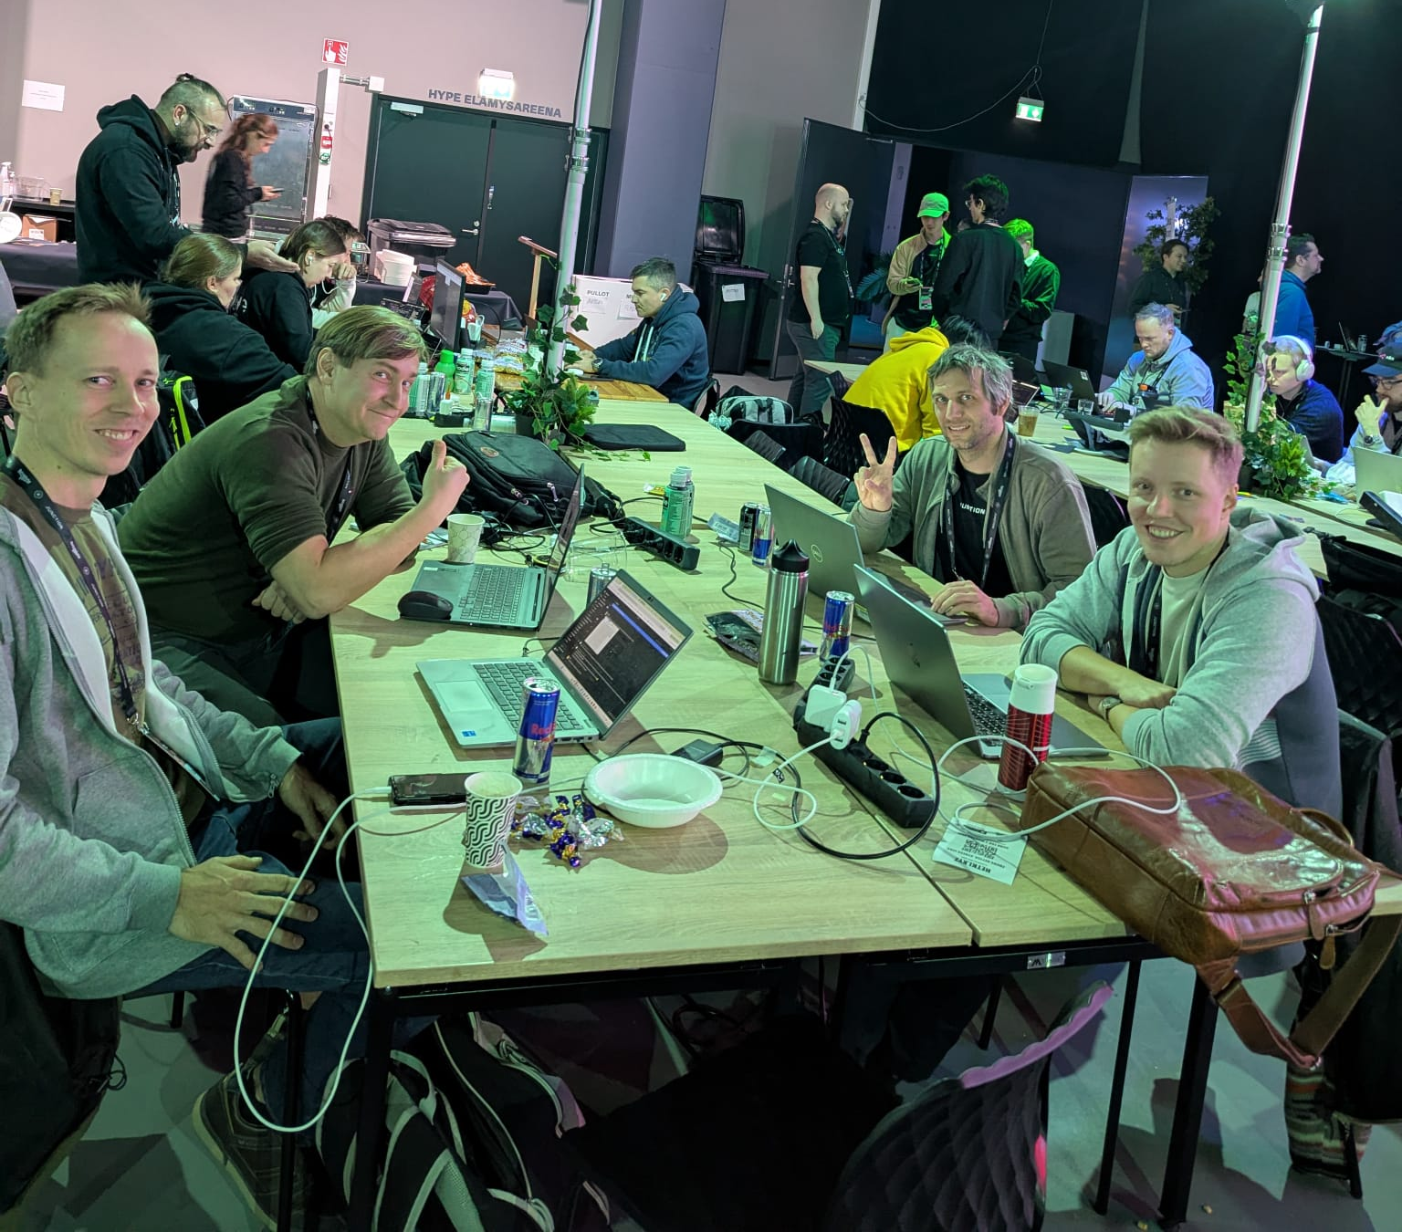
TEAM SENIOR OVERFITTERS
Valter: Fullstack developer. Co-founder and CTO of Astra
Svante: AI Weather Forecast Scientist. PhD. Co-founder of Skyfora
Andreas: Aerospace Engineer. Software Developer
Markus: Energy Market Analyst
Ossi: Software Developer
Notes:
--- The core challenge involves developing a smart control system for sewage pumps that optimizes flow management, reduces energy consumption, and improves system reliability in variable conditions. Image source: Microsoft 365 content library

